Slide 1
Team Information
Name: Digital Gearheads
Members: Ben Carhart, David Czechowski, Mark Erikson
Project Overview
Mission statement: "To design and develop Chameleon, an adaptive Integrated Development Environment designed for instructional purposes. The goal of the Chameleon I.D.E. is to provide an environment with which an introductory computer science students can be comfortable in, and also have the ability to adapt with the student as the skill and functionality needs of the student change."
Basic concept: an IDE whose features and complexity can be set by the prof
Targeted at CS 1210/1220 students (ie, students with experience ranging from none to about one year), and their prof

Slide 2
Major Features
Text editor with syntax highlighting
Command-line terminal connecting to a Linux server (think Putty embedded inside of Chameleon)
Code completion (start typing a word, the editor brings up possible endings)
Debugger
Basic project handling
The ability for the prof to turn each of those on or off
Other Requirements
Must run under Windows, since this will most likely be run on lab or student computers
File IO for files on the Linux server
Terminal’s goal is to give students exposure to Linux

Slide 3
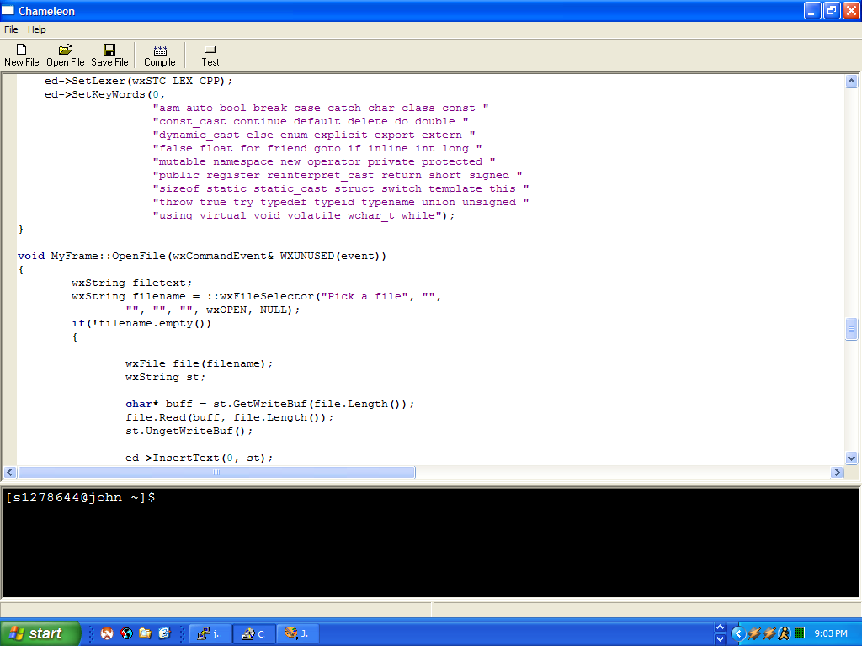
As a semester progresses, the program goes from this:

Slide 4
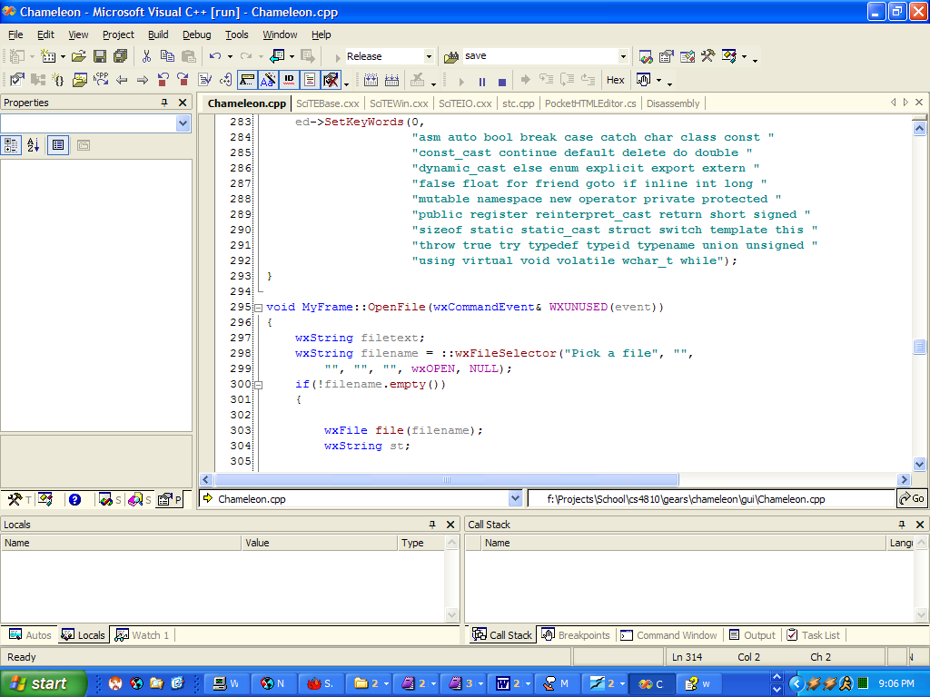
To something reasonably similar to this:

Slide 5
Project architecture
GUI
Editor
Compiler
Debugger
Permissions
Networking
Design notes
Major emphasis on using pre-built items
Scintilla editor widget provides syntax highlighting, code completion, etc
Terminal functionality provided by plink
File manipulation provided by pscp
GUI created using wxWindows
Debugger is a wrapper around GDB
Many examples of most of what we're doing (GUI wrapper for GDB, use of Scintilla, etc) – problem is trying to figure what we can learn from them

Slide 6
Network Interface:
Receives:
start network
stop network
change user (stop -> change attributes -> start)
Attributes: (gets and sets)
isConnected [boolean]
keepAlive [boolean]
user [string]
password (?) [string]
server [ip address]
presentWorkingDirectory (pwd) [string] -- dunno
Emits:
TBD
GUI Needs:
request for windows
request for message boxes
Compiler:
Receives:
start compile
Emits:
compilation errors
Attributes: (gets and sets)
includes locations [array of strings]
file/files [array of strings]
autoStartProgram [boolean]
GUI Needs:
request windows
request message boxes

Slide 7
GUI:
Receives
New / Open / Save / Save All files
Compile button
Compile all files in project ?
Run program
Debugger controls (pause,stop,continue,step,breakpoints)
Emits:
instantiates editor, etc.
GUI Features
Project file list
Debugger display
Tabbed file editor interface
Editor:
Receives:
Instantiation from GUI Manager
Complexity levels from permissions manager
Emits:
Establishes the GUI complexity to the GUI manager
Attributes:
an editor
complexity level
GUI Needs:
Syntax highlighting
Auto completion
Code folding

Slide 8
Debugger Sub Model
Accepts
go(arg_list) --activates the debugger
setDetails(arg_list) --sets specifics for debugger working environment (not defined)
setBreakpoint(arg_list) --sets a line for a breakpoint
clearBreakpoint() --clears set breakpoints
Requests
format: function() >>intended receiving manager --description
isCompiled() >>compiler --checks to see if the current file is compiled
getExecutable() >>compiler --gets the executable’s location & name
changeFocus() >>GUI --changes highlighted line during debug
Responds
getPermissions() >>any --gets the debugger’s current permissions status
Permissions Control Sub Model
Accepts:
getMyPermission(arg_lst) --based on arg_lst returns true or false to indicate that object’s activity
setLevel(arg_lst) --sets permissions based on arg_lst. arg_lst might be a character string
Requests:
Responds:
format: function() >>intended calling manager --description
currentLevel() >>GUI_ --returns an integer revealing current permissions level

Slide 9
Tasks
Completed Tasks
Documentation: PMP 1.0, SCMP 1.0, SRS 1.0, SRS 1.5, 2.0
Documentation is in CVS, and browseable via CVS
Initial research for GUI, networking,
Simple editor running (w/ syntax highlighting, basic local file IO)
Initial modeling
Current Tasks
SDD 1.0
Initial coding (basic GUI layout, etc)
Terminal wrapper interaction tests

Slide 10
Future Tasks:
Near Term (2-3 weeks out)
SDD 2.0
Coding for first iteration
Longer Term (>3 weeks out)
Further research for networking / terminal issues
More modeling as we get more understanding of how things will interact
Serious coding

Slide 11
Process Examination
How's the process going?
  We had a hard time initially getting things done because team assignments weren't spelt out clear enough so as to be able to definitely say whether something was done or not
What have you done well?
  We met fairly consistently, worked on documentation, and procrastinated very well
What have you done poorly?
  Laying out definite, concrete tasks other than documentation assignments
What adjustments are you going to make?
  Do a better job of defining and tracking upcoming tasks

